Slide 1
Elementary and Secondary School Emergency Relief (ESSER) Roundtable Series ARP Homeless: How Schools/Districts are using ARP ESSER Funding to Assist Students Experiencing Homelessness
New Jersey Department of Education
Division of Educational Services
December 14, 2022
Notes:
Anthony

Slide 2
Agenda
Housekeeping Ms. Peggy Porche, Planning Associate
Office of the Executive Director/Deputy Assistant Commissioner
Greetings/Welcome Dr. A. Charles Wright, Executive Director/Deputy Assistant Commissioner
Division of Educational Services
ARP Homeless Ms. Tamira Chapman, ARP-HCY Coordinator
Office of Supplemental Educational programs
Regional Programs
Region III
Clifton Public Schools
Notes:
Anthony

Slide 3
Using Microsoft Teams
Chat
We welcome your participation in discussions by asking questions and adding comments in the chat box.
Raise Hand
Please use the raise hand feature if you want to speak.
Mute/Unmute
Please remain muted whenever you are not speaking.
Notes:
Peggy

Slide 4
Greetings/Welcome Dr. A. Charles Wright Executive Director/Deputy Assistant Commissioner Division of Educational Services
Notes:
Kathy
The next few slides review the allowable uses of the ESSER funds.
Next slide

Slide 5
ARP Homeless: How Schools/Districts are using ARP ESSER Funding to Assist Students Experiencing Homelessness
Notes:
Kathy
The next few slides review the allowable uses of the ESSER funds.
Next slide

Slide 6
Ms. Tamira Chapman, ARP-HCY Coordinator Office of Supplemental Educational Programs

Slide 7
About ARP-HCY Funds
ARP-HCY funds are specifically dedicated to support the identification, enrollment, and school participation of children and youth experiencing homelessness, including through wrap-around services.
Funds may also be used for specific and urgent needs due to the extraordinary impact of the pandemic on students experiencing homelessness, include academic, social, emotional, and mental health needs.
Notes:
ARP-HCY funds provide significant opportunities for schools and State agencies to increase their capacity to identify and support children and youth experiencing homelessness. At a time of growing need, ARP-HCY funds have the potential to create lasting changes in how our LEAs meet urgent needs and respond to student homelessness. In addition to services funded under ARP-HCY, McKinney-Vento programs provide homeless students with protections and services to ensure they enroll in and attend school; complete their high school education, and be positioned for success after graduation; thereby, helping them avoid poverty and homelessness as adults.

Slide 8
ARP-HCY Funding
New Jersey Department of Education (NJDOE)
 | EHCY | ARP Homeless I (25%)​ | ARP Homeless II (75%)​
Total Allocation | $2,693,280 | $4,527,381 ​ | $13,590,844 ​
State Level Set-aside (25%)​ | $441,116 | $1,131,845 ​ | $1,394,747 ​
LEA Allocation (75%)​ | $2,252,164 | $3,395,536 ​ | $12,196,097​
Notes:
President Biden signed the Federal American Rescue Plan (ARP Act). In addition to providing $122 billion in Elementary and Secondary School Emergency Relief (ARP ESSER) to States and school districts, the Act required the United States Department of Education (The Department) to reserve $800 million for Homeless Children and Youth (ARP-HCY). This funding is directed to support efforts to identify homeless children and youth, provide them with comprehensive, wrap-around services that address needs arising from the pandemic and allow them to attend school and participate fully in all school activities.
Based on the proportion States received under Title I, Part A for the most recent fiscal year, the New Jersey Department of Education (NJDOE) was awarded $18,118,225.

Slide 9
Questions and Contact
Contact Information
Tamira Chapman
Office of Supplemental Educational Programs
tamira.chapman@doe.nj.gov
609.376.3432
Notes:
Introduce Region III Coordinator Alan Ferraro

Slide 10
Regional Presentations

Slide 11
Mr. Alan Ferraro, Region III
Notes:
Anthony

Slide 12
ARP-HCY I / M.O.E.S.C. ~ Region III (1 of 7)
Strategic Plan
Monarch Housing Associates
Rutgers University/Bloustein School of Planning and Public Policy
Identification Data-Homeless Students
School District/Region Data Development
Navigator recommendation – Care Management Organization (CMO)

Slide 13
ARP-HCY I / M.O.E.S.C. ~ Region III (2 of 7)
NAVIGATOR - 1 per County
Reinforce Existing Agency Service Collaboration
Social Service
Education
Housing

Slide 14
ARP-HCY I / M.O.E.S.C. ~ Region III (3 of 7)
Navigator-Social Service Collaboration
Public/Private Social Service Coordination
Medical Service Coordination
Food/Household Needs Coordination
Faith Based Intervention

Slide 15
ARP-HCY I / M.O.E.S.C. ~ Region III (4 of 7)
Navigator – Housing
Coordinated Entry Housing Agency
State/County Housing Agencies
Private Housing Services
Housing Application Coordination

Slide 16
ARP-HCY I/ M.O.E.S.C. ~ Region III (5 of 7)
Navigator –Ocean/Monmouth Counties
New Jersey Integrated Care for Kids (InCK)
Medicaid Service
Medical Service

Slide 17
ARP-HCY I / M.O.E.S.C. ~ Region III (6 of 7)
Additional ARP–HCY I Services
Inter-faith Hospitality Network
Faith Based Intervention
Family Promise
180 Turning Lives Around
Dottie’s House
Harbor House
HomeFront
Women Aware
Emergent Transportation to Agency/School of Origin
Emergent – Short Term Homeless Transportation

Slide 18
ARP-HCY II/ M.O.E.S.C. ~ Region III (7 of 7)
Additional ARP-HCY II Services (District Application Submission)
Academic Support
Gas/Meal Gift Cards
Before School/Aftercare Program
Limited Excess Cost of Transportation
Limited Short Term Temporary Housing (emergent 2-3 day motel/hotel stays)

Slide 19
Questions and Contact (MOESC)
Contact Information
Alan Ferraro
Monmouth-Ocean Educational Services Commission
aferraro@moesc.org
732-695-7832

Slide 20
Ms. Jessica Tremble Clifton Public Schools
Notes:
Anthony

Slide 21
ARP-HCY Grant Allotment

Slide 22
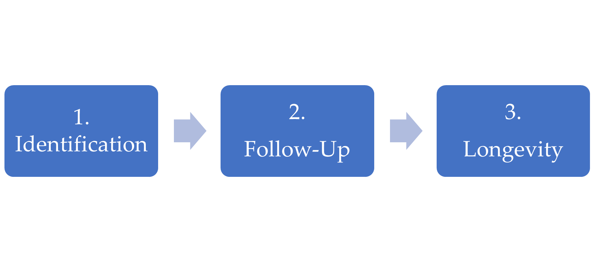
Address Areas of Concern

Slide 23
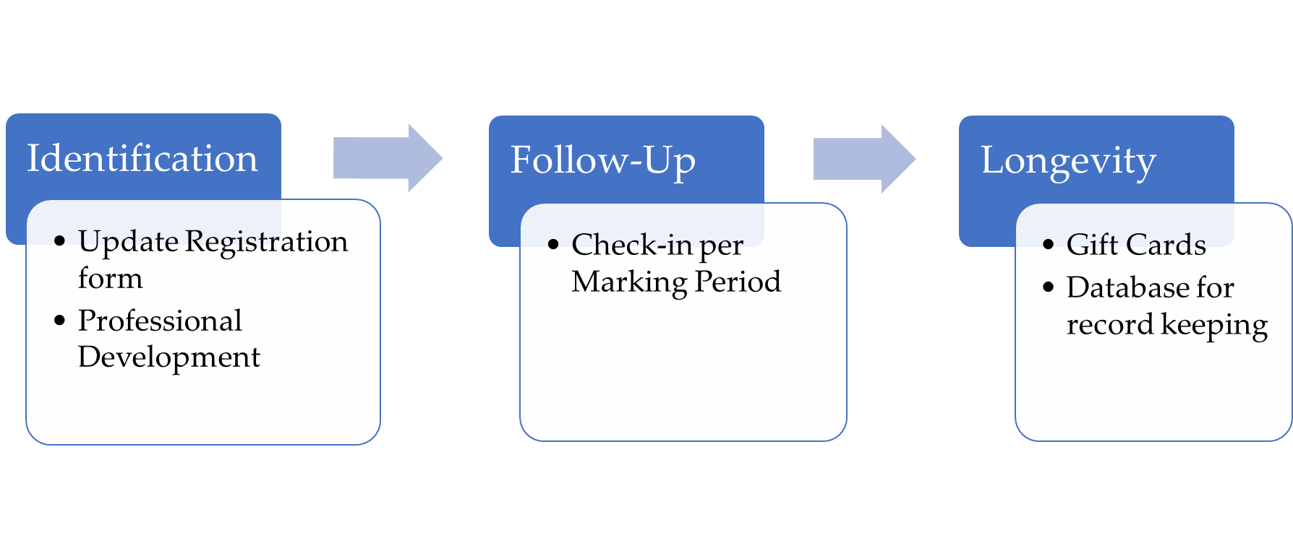
Address Areas of Concern (cont.)

Slide 24
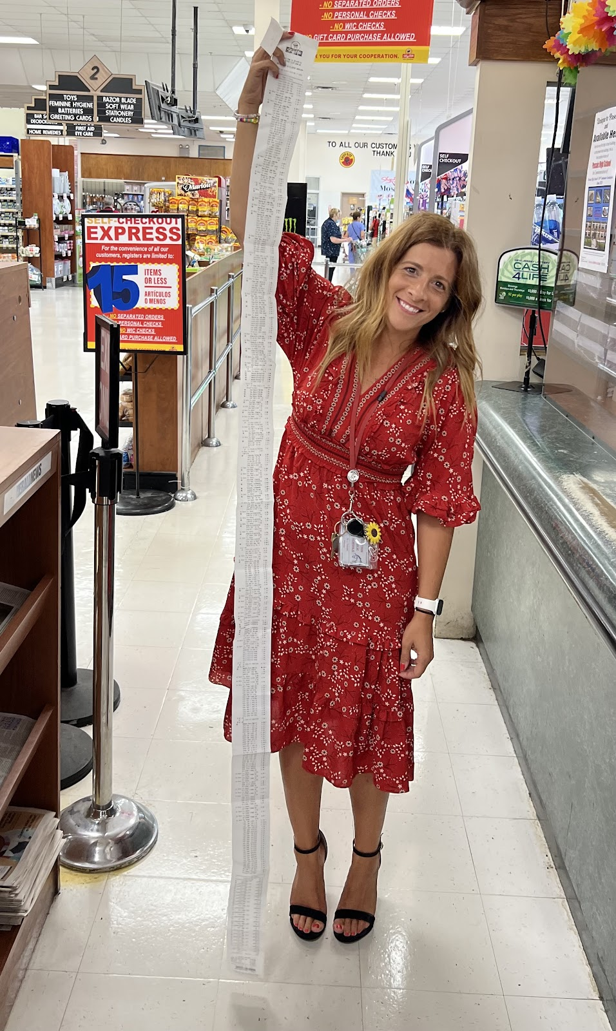
Gift Cards
Food
Housing Supplies
Shoprite
Shoprite

Slide 25
Gift Cards(cont.)
Clothing
Transportation
Old Navy
Macy’s
Gap
American Eagle
Marshalls
Shell
BP
Exxon

Slide 26
Additional Supports

Slide 27
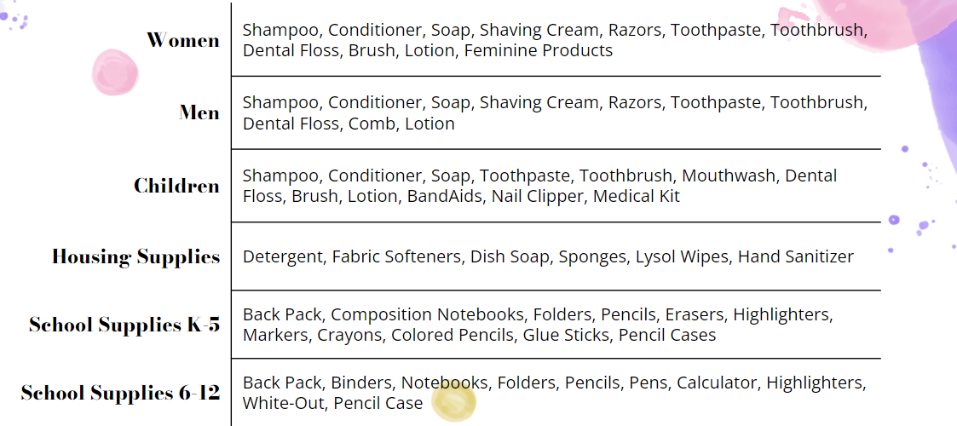
Personalized Kits

Slide 28
Questions and Contact (CPS)
Contact Information
Jessica Tremble
Clifton Public Schools
Jtremble@Cliftonschools.net
973-470-5697

Slide 29
Thank You!
New Jersey Department of Education Website nj.gov/education
Questions may be submitted to:
ESSER@doe.nj.gov
Registration now open for the January 25, 2023, ARP ESSER Round Table at
https://homeroom5.doe.state.nj.us/events/
Follow Us!
Facebook: @njdeptofed
Twitter: @NewJerseyDOE
Instagram: @NewJerseyDoe
Notes:
Anthony

